Slide 1
Student Health Insurance Program

Slide 2
How Does Insurance Work Here?
In the USA, medical expenses are very costly and without medical insurance, you can owe exorbitant amounts for healthcare.
The SUNY International Health Insurance Plan will help pay for medical bills that you will incur when you go to the doctor, hospital, or pick up prescription medication.

Slide 3
How Do I Enroll?
This insurance policy is mandatory and is included in your SUNY tuition fees for your protection.
This plan includes:
-Preventative (Wellness) Care and Sickness/Injury Coverage
-Medical, Security, Political, and Natural Disaster Evacuation/Repatriation
Coverage is available voluntarily for your spouse and for your child(ren)

Slide 4
What Does This Plan Cover?
Preventative Care
Primary Care Office Visits
Urgent Care Visits
Emergency Care
Inpatient/Outpatient Hospital Care
Mental Health Services
Required Immunizations
Prescription Drugs
Labs and Imaging
Ambulance
Maternity and Nursery Care for a Covered Pregnancy
Tel-A-Doc (refer to brochure)
Medical, Political, Natural Disaster Evacuation and Repatriation

Slide 5
What Is My Out of Pocket Expense?
Deductible – The amount you must pay annually before the insurance kicks in. The deductible for this policy is $200 for in-network care when you are seen outside of the student health center.
Coinsurance – The cost you are required to pay each provider. The coinsurance amount for this policy is 0% for in-network care.
Co-Pay – A fixed amount you pay directly to the provider at the time of service. This amount varies depending on the type of covered service.
In-Network – Group of providers you must go to for the most cost-effective pricing.
Please see video here for explanation of common insurance terminology

Slide 6
Summary of Plan Benefits
Plan Design (Per Person, Annually) | In-Network Benefits | Out of Network Benefits
Annual Deductible | $200 (student pays this 1 time, annually, not with each visit) | $400 (student pays this 1 time, annually, not with each visit)
Coinsurance | 0% | 10%
Preventative Care Services | Covered in full (annual physical, OBGYN) | 10% after deductible
Primary Care Visit | $0 after deductible | $50 copay then 10% coinsurance after deductible
Urgent Care Visit | $0 after deductible | $50 copay then 10% coinsurance after deductible
Emergency Room | $0 after deductible | $0 after deductible
Ambulance | $0 after deductible | $0 after deductible
In-Patient Hospital Care | 0% after deductible | 10% after deductible
Prescription Drugs | $10 (tier 1)/$20 (tier 2)/$20 (tier 3) | $10 & 10% coinsurance (tier 1), $30 & 10% coinsurance brand

Slide 7
How Do I Get Started?
You will receive an email from notifications@uhcsr.com that an ID card is available for you.
To view, download or request a hard copy ID Card, please visit here (https://myaccount.uhcsr.com/)

Slide 8
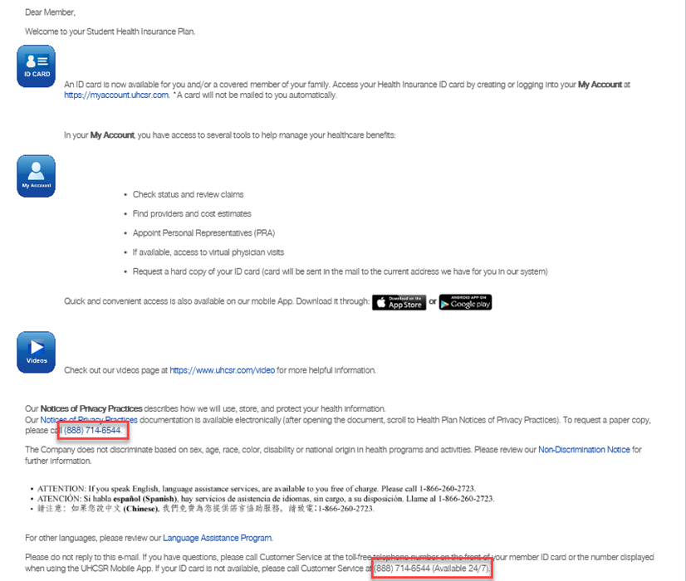
This is what the email looks like ☺

Slide 9
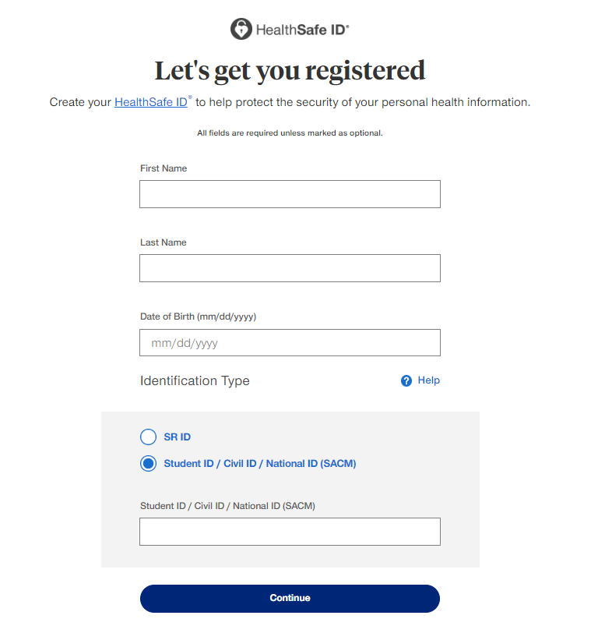
This is what the screen looks like to create your account for the first time so that you can grab your Health Insurance ID Card

Slide 10
You Can Access Your Account from Your Computer, iPad or SmartPhone 24/7

Slide 11
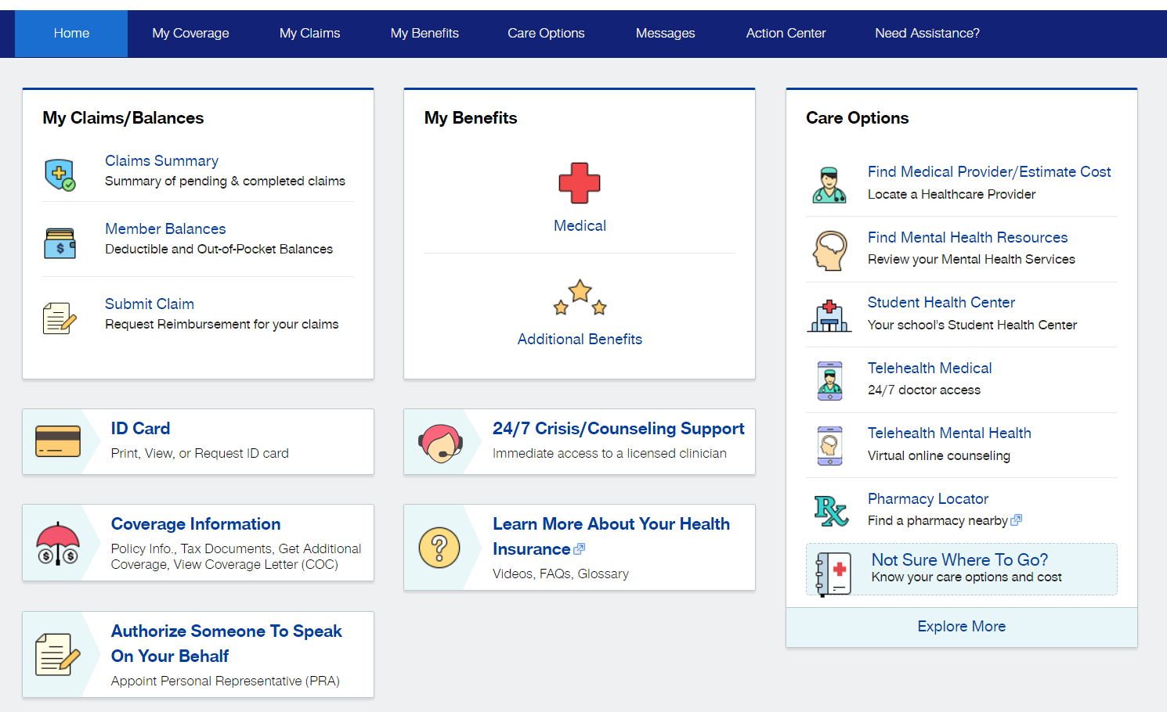
Here’s What You Can Do In Your UHC Account

Slide 12
Telehealth Services- Mental & Physical
Process: member visits the HealthiestYou app and completes a questionnaire. Member provides their UHCSR insurance information from UHCSR ID card, emergency contacts and their goals for the service. The questionnaire will also ask for counselor preferences (gender, specialty, etc.) to ensure member is matched with a practitioner that can help meet their goals
Within 24 hours after completing the questionnaire, the member will be contacted by a counselor to schedule an appointment and decide on a communication method that best suits their needs

Slide 13
Landing Page For Physical & Mental TeleDoc Services
Notes:
13

Slide 14
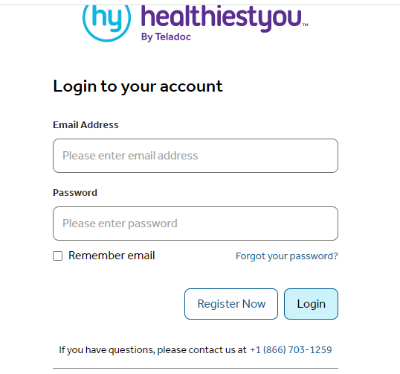

Slide 15
What Will My Health Insurance ID Card Look Like?

Slide 16
Summary of Dental Plan Benefits
Dental coverage for all enrolled students and voluntary option to enroll their dependents
Ameritas Nationwide Network

Slide 17
Need Support?
For Health Insurance Plan or Claim Assistance
888-714-6544 or email customerservice@uhcsr.com
To Locate a Provider click here
For General Assistance
866-535-0456 or student@haylor.com

Slide 18
Thank You, On Behalf Of The HFC Collegiate Team

